Slide 1
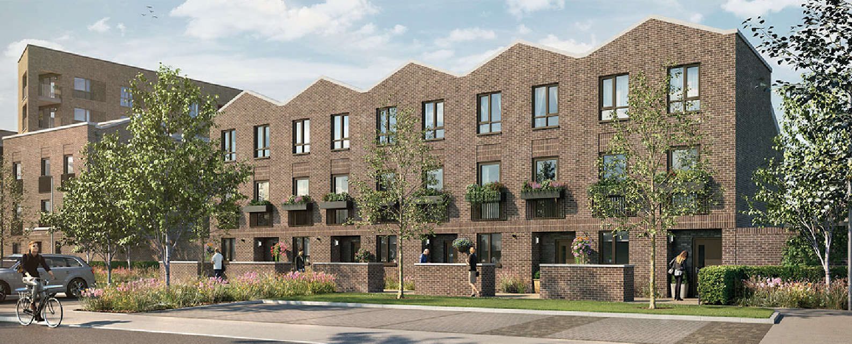
Kensington Fields
Development update
Issue 1 | Feb 2025
Keeping you updated
We wanted to provide you with an update on the developments and what you can expect from us over the coming months.
Site Activity
Sales Office Open 7 days a week 10am till 5pm
Show Homes and View Home available to view 7 days a week
Overview
Overview of what’s being built. In addition, the development will provide:
200 Homes, including 60 affordable homes
16 Homes created in renovated buildings
After Care Enquiries
Should you wish to contact us, please call 0808 169 5139. Our out of hours service has professional specialists on call 24 hours a day, 365 days a year

Slide 2
Timeline
Attenuation Ponds already installed to the development
LEAPS to be installed near to apartments once the area in practical and safe to access
Adoption dates for Road and Public Footpaths to be carried out with in the 12 months following completion of the development
Managing agent
RMG are acting as the Management Company for the Kensington Fields development,
They will ensure maintenance of all the communal spaces and any areas of the development not scheduled for public adoption
Your sales executive will have provided you with information relating to the management company and their obligations.
Ecology
Over 1000m of hedgerow planted
Insect friendly installations such as log piles and insect hotels
Wildflower Meadow Installed
18 Square Meters of Bulb planting
262 New trees planted in public open spaces
Hedgehog Highway linking public spaces to private gardens
Services
Gas and Electricy – British Gas
Water – IWNL for the majority of the development although some plots are serviced by Yorkshire Water, information available on request
Fibre – BT and VM

Slide 3
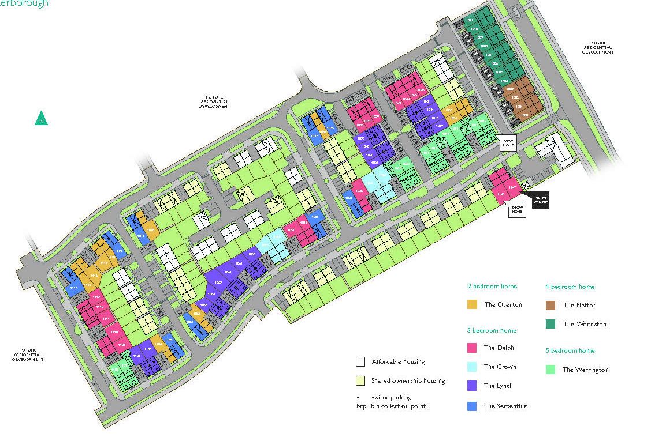
Development layout plan
How will the development benefit the local community?
Kensington Fields will also support the local community by contributing over £2.6 million towards:
S106 contributions, local donations
£692k towards highways improvements
£595k contribution to local sports pitch
£1mil towards local education
£142k towards local open spaces
We will also be providing:
Local Travel Plan
On Site Trim Trail
Play Area and Kick About Space
Sustainable Urban Drainage Basin
Please be aware that the dates and information provided are correct at time of print and are dependent on a number of factors, including weather, so are subject to change. Also note that the site plan referenced is the current phase of build, a more comprehensive site plan, detailing surrounding development, is available on request
Thank you for your patience while the construction work is taking place. We try to keep disruption to a minimum but appreciate it can be noisy and dirty at times so do contact us if you have any questions, or if you’d like to provide any feedback, by emailing:
Kensington Fields@Countryside
GDD52316/11.19

